Slide 1

CREATE TEST SCRIPT
Copyright © 2018 by KhanhTran at Testmaster.vn

Slide 2






CREATE TEST SCRIPT FLOW
Webpage under test
Test Script
Page Object Model
Automation Tester
Selenium Webdriver

Slide 3
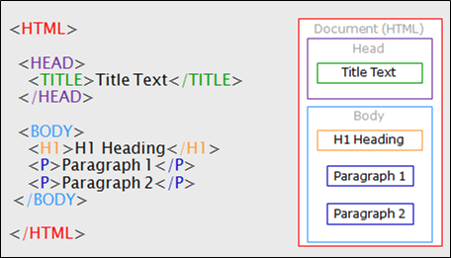
HTML – STRUCTURE OF WEB PAGE
HTML is the standard markup language for describing the structure of Web page.
The content is presented by HTML Element, each Element have open tag and close tag. Content is placed between them. <p>Welcome to Testmaster.vn </p>
Browser do not display the HTML tags, but use them to render the content of the page.
Each HTML page have two parts are Head and Body. Some describe tags are presented on Head and contents are presented on Body

Slide 4
HTML ATTRIBUTES
All HTML elements (tags) can have attributes
Attributes provide additional information about an element
Attributes are always specified in the start (open) tag
Attributes usually come in name/value pairs like: name=“value”
Example
<a href="https://www.w3schools.com">This is a link</a>
To create automation test script, we can use HTML Attribues to refer to specific element on web page with some popular attributes such as: ID, Name, Class, TagName
In some case we can’t build the POM by HTML Attributes. The CSS Selector is used as a better way

Slide 5
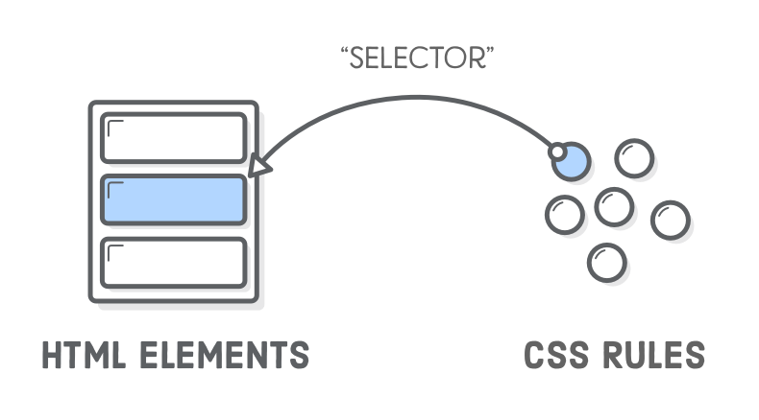
CSS SELECTOR
A CSS Selector is a combination of an element selector and a value which identifies the web element within a web page.
They are string representations of HTML tags, attributes, Id and Class.
Dot (.) refers to class
css=inputs.submitbtn
Hash (#) refers to Id
css=input[id=email]
The attribute is placed between [ and ]
css=input[name=email]
Using CSS locators, we can also locate elements with sub-strings.
‘^’ symbol, represents the starting text in a string.
‘$’ symbol represents the ending text in a string.
‘*’ symbol represents contains text in a string.

Slide 6
CSS SELECTOR
Child Selectors
Css=form>label>input[id=PersistentCookie]
Css=form label

Slide 7
XPATH
Xpath is designed to allow the navigation of XML documents, with the purpose of selecting individual elements, attributes or some other part of an XML document for specific processing.
Absolute Xpath starts with the root node or a forward slash (/).
The advantage of using absolute is, it identifies the element very fast.
Disadvantage here is, if any thing goes wrong or some other tag added in between, then the path will no longer works
Relative Xpath is one where the path starts from the node of your choise – it doen’t need to start from the root node. It starts with Double forward slash (//).
Example: //table/tbody/tr/th
We can use * for selecting all the element nodes. //*[@id=‘username’]

Slide 8
PAGE OBJECT PATTERN
The PageFactory class in Selenium is an extension to the Page Object design pattern. It is used to initialize the element of the Page Object or instantiate the Page Object itself.
It is used to initialize elements of a page class without having to use ‘FindElement’ or ‘FindElements’.
The Annotations can be used to supply descriptive names of target objects to improve code readability.

Slide 9
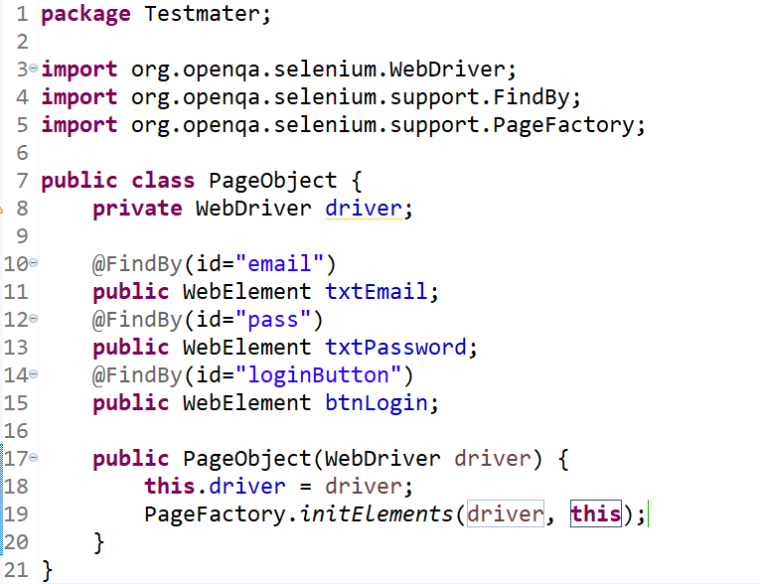
PAGE OBJECT PATTERN

